Slide 1
Feature Selection 방법론 제안
-월간보고회의(5월)-
BAE LAB.
Department of Industrial Engineering, Pusan National University

Slide 2
Contents
이미지 유사도 측정 (MSE)
Dynamic Time Warping (DTW)

Slide 3
Introduction
Feature Selection 아이디어
KMI 데이터는 계절성의 영향보다는 추세의 영향이 매우 큰 것을 확인 (2018년 이후 데이터 사용)
추가적인 방법론을 적용하여 변수 선택에 대한 근거 마련
값을 기반으로 하는 Correlation과 차별화된 그래프의 형상을 기반으로 하는 Image Similarity 측정
⇒ Mean Squared Error 사용
Dynamic Time Warping을 사용하여 시계열 데이터 유사성 측정

Slide 4
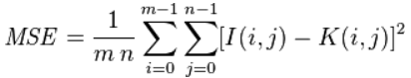
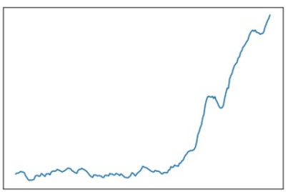
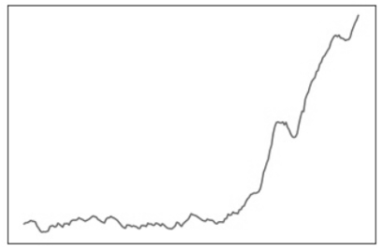
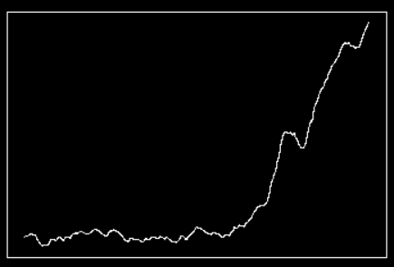
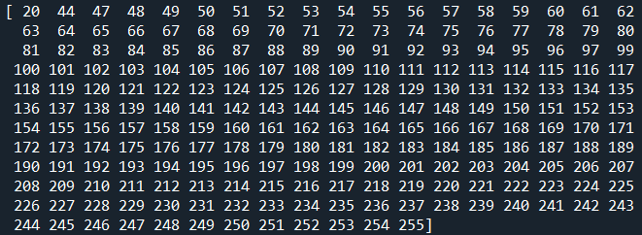
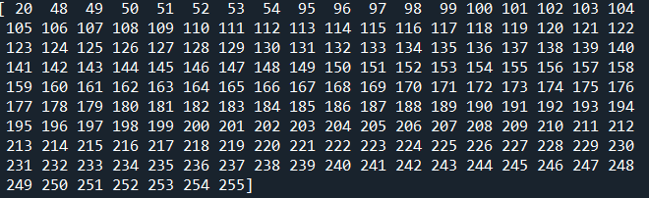
이미지 유사도 측정 (MSE)
Mean Squared Error
두 이미지의 각 픽셀간 차이를 평균 내어 유사도를 파악
전처리 과정
<원본>
<흑백>
<Threshold>
•3 Channels
•다양한 Pixel 값
•1 Channel
•다양한 Pixel 값
•1 Channel
•고정된 Pixel 값

Slide 5
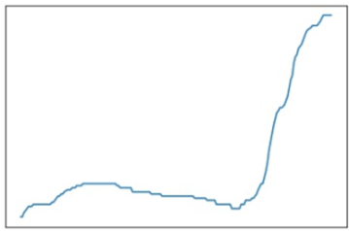
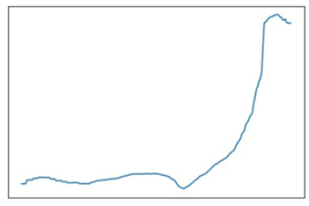
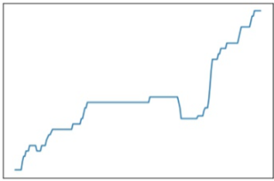
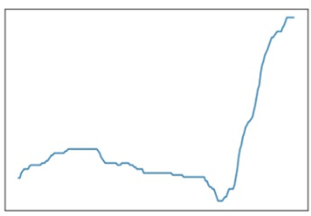
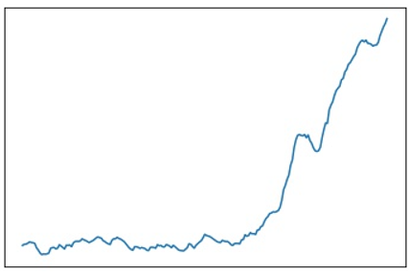
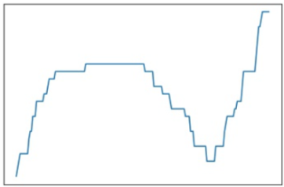
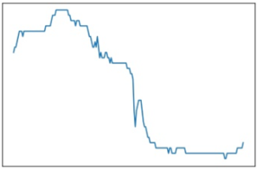
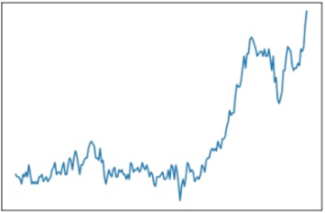
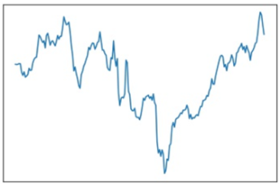
이미지 유사도 측정 (MSE)
1
2
3
4
Newbuilding Prices(13000,13500 TEU)
-8 week lag : 577.0
Average Earnings
-4 week lag : 585.36
Newbuilding Prices(3500, 4000 TEU)
No lag : 602.61
Newbuilding Prices(13000,14000 TEU)
-8 week lag : 617.24
5
6
7
8
SCFI
Newbuilding Prices(1650,1850 TEU)
+8 week lag : 713.41
5 Year Finance based on Libor
-8 week lag : 799.12
PCI- West Coast North America
+8 week lag : 1090.23
Bunker Prices
+8 week lag : 1114.27

Slide 6
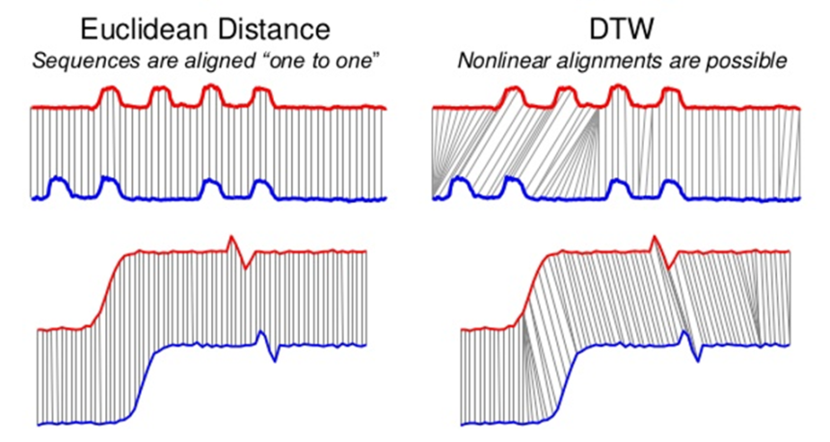
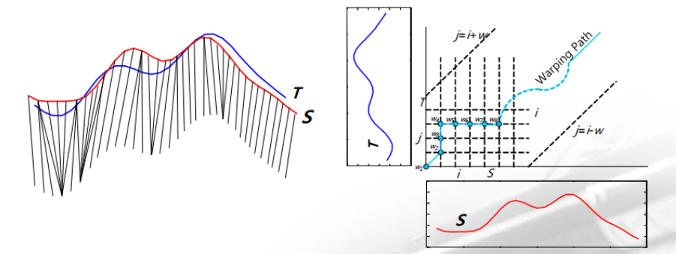
Dynamic Time Warping
유클리드 거리의 한계 : 동일 시점의 거리를 계산하기 때문에 패턴이 같아도 시작점이 다르면 다르게 인식
동일한 시간선상의 데이터뿐만 아니라 주변 요소까지 비교쌍으로 사용하여 정확도를 높이는 방식
서로 다른 길이의 시계열의 유사도 분석이 가능하며 과거의 값을 고려 가능

Slide 7
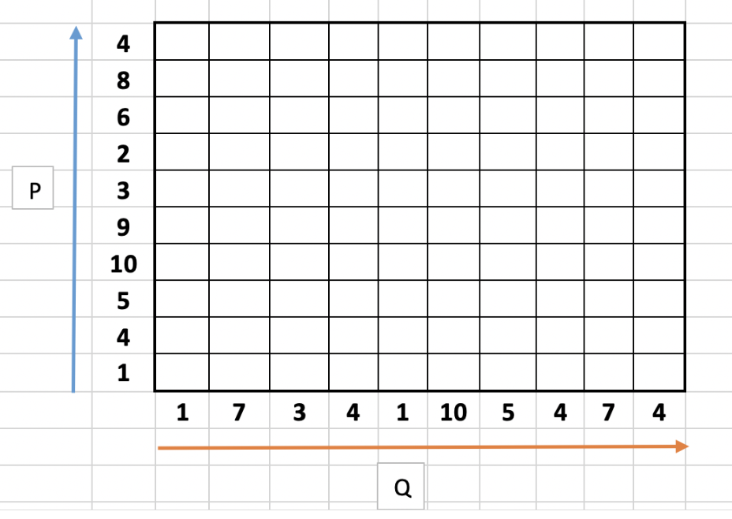
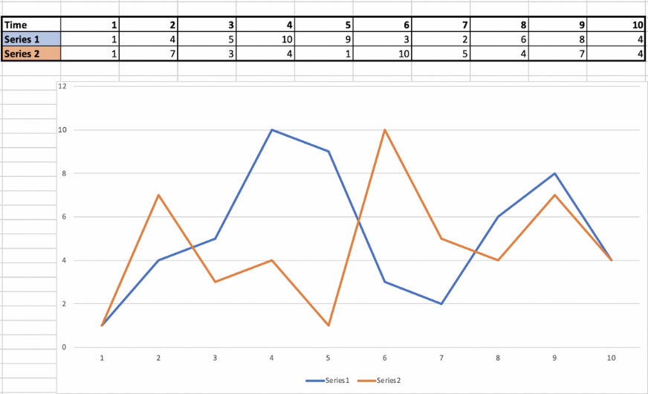
Dynamic Time Warping
알고리즘 설명
Cost Matrix

Slide 8
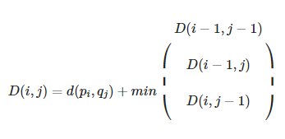
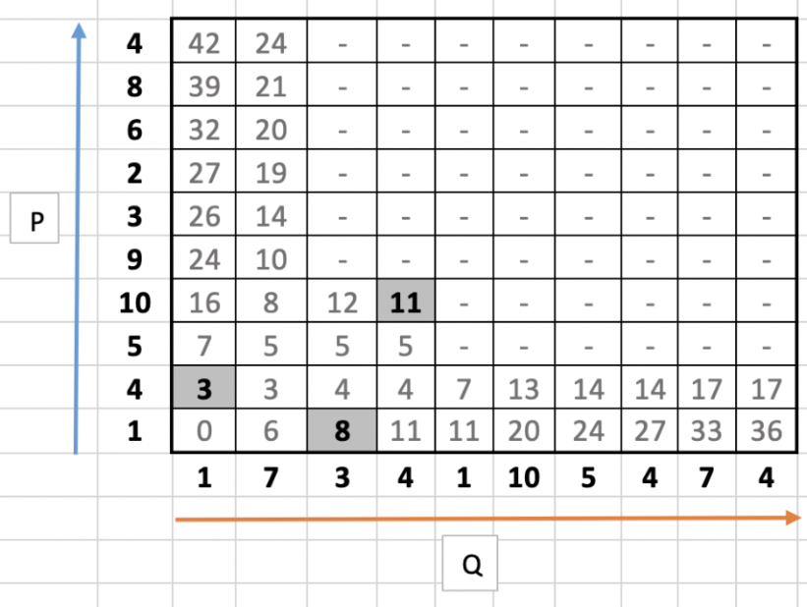
Dynamic Time Warping
알고리즘 설명
Cost Matrix
1
3
|1 - 4| + min(0, X, X) = 3
2
8
3
|3 - 1| + min(6, X, X) = 8
1
1
11
2
|4 - 10| + min(12, 5, 5) = 11

Slide 9
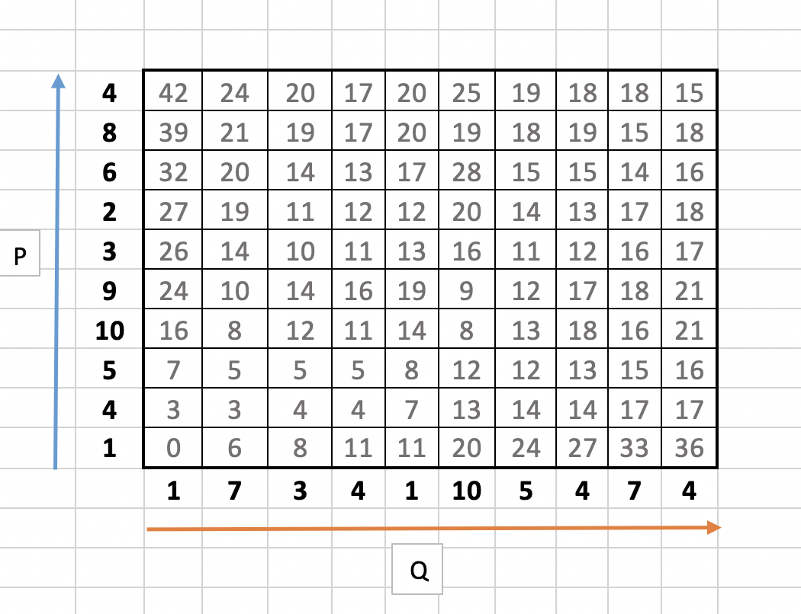
Dynamic Time Warping
알고리즘 설명
Warping Path
Warping Path
= [15, 15, 14, 13, 11, 9, 8, 8, 4, 4, 3, 0]
DTW Distance
= (15+15+14+13+11+9+8+8+4+4+3+0) / 12
= 8.67

Slide 10
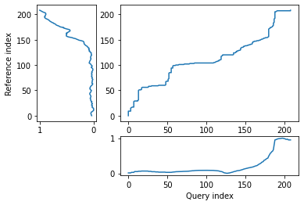
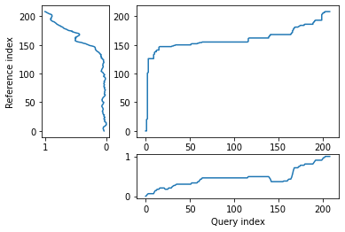
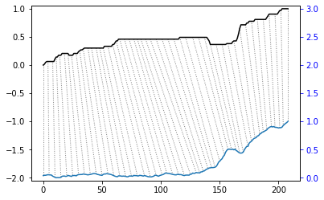
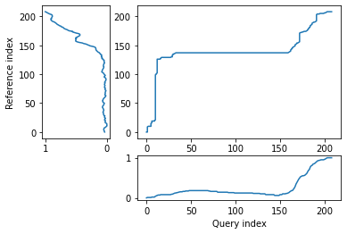
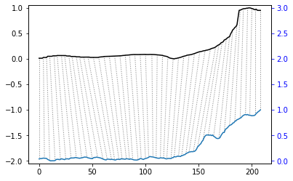
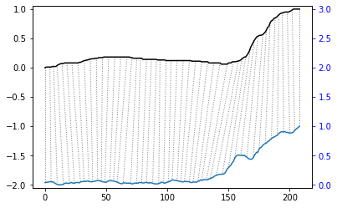
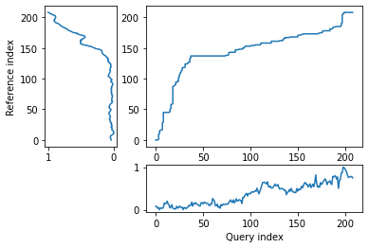
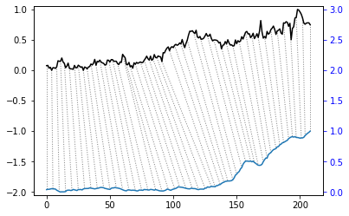
Dynamic Time Warping
알고리즘 적용
Average Earnings : 3.789
Newbuilding Prices(3500,4000 TEU) : 5.245
1
2
Newbuilding Prices(13000,13500 TEU): 6.732
PCI-Comprehensive: 10.623
3
4

Slide 11
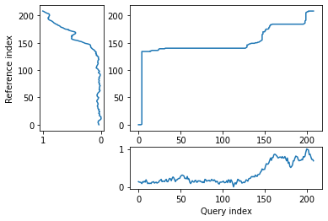
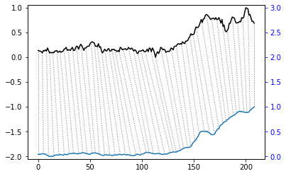
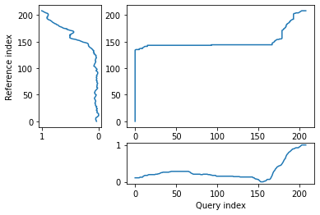
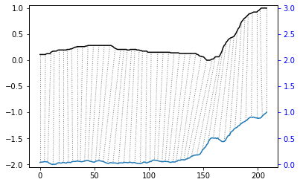
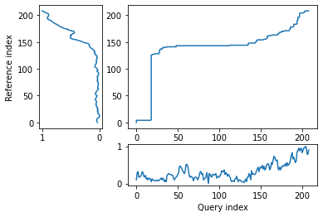
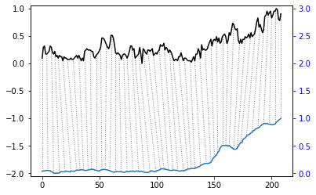
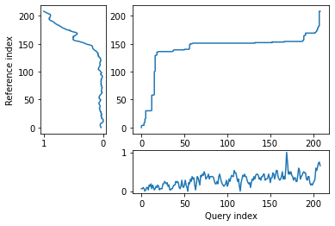
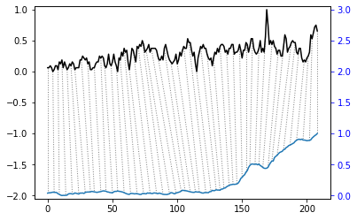
Dynamic Time Warping
알고리즘 적용
PCI- West Coast North America : 15.991
Newbuilding Prices(13000,14000 TEU): 18.542
5
6
PCI- East Coast North America : 19.172
PCI- Mediterranean,Black Sea : 22.401
7
8

Slide 12
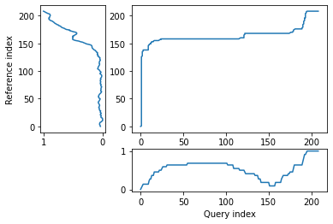
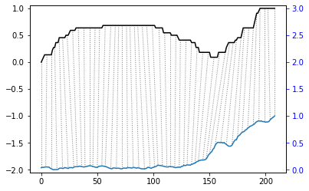
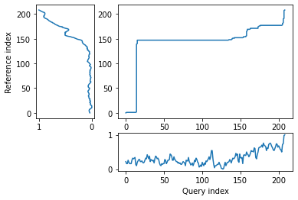
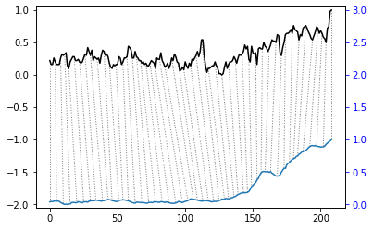
Dynamic Time Warping
알고리즘 적용
Newbuilding Prices(1650,1850 TEU) : 25.190
PCI- United Kingdom,Continent : 25.574
9
10

Slide 13
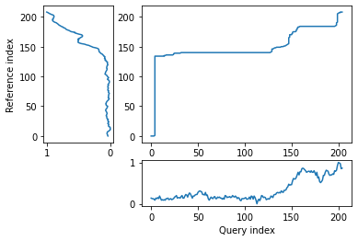
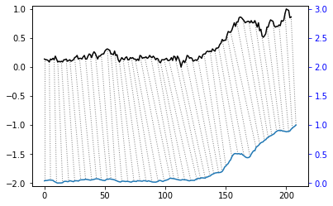
Dynamic Time Warping
알고리즘 적용
변수 PCI- West Coast North America에 lag를 적용 후 DTW 적용
Correlation 방법론에서 입증된 효과를 DTW에서 검증
DTW Distance : 15.991
DTW Distance : 14.916

Slide 14
Conclusion
각 Feature Selection 방법론에서 공통 혹은 다수로 추출된 변수 최종 선택
Original data
Clarksons Average Containership Earnings
HSFO 380cst Bunker Prices (3.5% Sulphur), Rotterdam
Total Containerships - % Idle/Laid Up/Scrubber Retrofit
Total Containerships - % Idle/Laid Up/Scrubber Retrofit
Containership 1,650/1,850 TEU FCC, G'less Newbuilding Prices
Containership 13,000/14,000 TEU Newbuilding Prices
Containership 3,500/4,000 TEU (Wide Beam) G'less Newbuilding Prices
Containership 13,000/13,500 TEU G'less Newbuilding Prices
5 Year $10m Finance based on Libor 1st yr
Exchange Rates South Korea
Exchange Rates Euro
Exchange Rates China
Port Congestion Index - Containerships In Port, m.TEU, 7dma
Port Congestion Index - Containerships In Port, East Coast North America, m.TEU, 7dma
Port Congestion Index - Containerships In Port, West Coast North America, m.TEU, 7dma
Port Congestion Index - Containerships In Port, United Kingdom/Continent, m.TEU, 7dma
Port Congestion Index - Containerships In Port, Mediterranean/Black Sea, m.TEU, 7dma
Port Congestion Index - Containerships In Port, East Asia, m.TEU, 7dma
Port Congestion Index - Containerships In Port, South East Asia, m.TEU, 7dma
Port Congestion Index - Containerships In Port, China P.R., m.TEU, 7dma
Correlation Anlaysis
Clarksons Average Containership Earnings
HSFO 380cst Bunker Prices (3.5% Sulphur), Rotterdam
Total Containerships - % Idle/Laid Up/Scrubber Retrofit
Total Containerships - % Idle/Laid Up/Scrubber Retrofit
Containership 1,650/1,850 TEU FCC, G'less Newbuilding Prices
Containership 13,000/14,000 TEU Newbuilding Prices
Containership 3,500/4,000 TEU (Wide Beam) G'less Newbuilding Prices
Containership 13,000/13,500 TEU G'less Newbuilding Prices
5 Year $10m Finance based on Libor 1st yr
Exchange Rates South Korea
Exchange Rates Euro
Exchange Rates China
Port Congestion Index - Containerships In Port, m.TEU, 7dma
Port Congestion Index - Containerships In Port, East Coast North America, m.TEU, 7dma
Port Congestion Index - Containerships In Port, West Coast North America, m.TEU, 7dma
Port Congestion Index - Containerships In Port, United Kingdom/Continent, m.TEU, 7dma
Port Congestion Index - Containerships In Port, Mediterranean/Black Sea, m.TEU, 7dma
Port Congestion Index - Containerships In Port, East Asia, m.TEU, 7dma
Port Congestion Index - Containerships In Port, South East Asia, m.TEU, 7dma
Port Congestion Index - Containerships In Port, China P.R., m.TEU, 7dma
Image Similarity (MSE)
Clarksons Average Containership Earnings
HSFO 380cst Bunker Prices (3.5% Sulphur), Rotterdam
Total Containerships - % Idle/Laid Up/Scrubber Retrofit
Total Containerships - % Idle/Laid Up/Scrubber Retrofit
Containership 1,650/1,850 TEU FCC, G'less Newbuilding Prices
Containership 13,000/14,000 TEU Newbuilding Prices
Containership 3,500/4,000 TEU (Wide Beam) G'less Newbuilding Prices
Containership 13,000/13,500 TEU G'less Newbuilding Prices
5 Year $10m Finance based on Libor 1st yr
Exchange Rates South Korea
Exchange Rates Euro
Exchange Rates China
Port Congestion Index - Containerships In Port, m.TEU, 7dma
Port Congestion Index - Containerships In Port, East Coast North America, m.TEU, 7dma
Port Congestion Index - Containerships In Port, West Coast North America, m.TEU, 7dma
Port Congestion Index - Containerships In Port, United Kingdom/Continent, m.TEU, 7dma
Port Congestion Index - Containerships In Port, Mediterranean/Black Sea, m.TEU, 7dma
Port Congestion Index - Containerships In Port, East Asia, m.TEU, 7dma
Port Congestion Index - Containerships In Port, South East Asia, m.TEU, 7dma
Port Congestion Index - Containerships In Port, China P.R., m.TEU, 7dma
Dynamic Time Warping
Clarksons Average Containership Earnings
HSFO 380cst Bunker Prices (3.5% Sulphur), Rotterdam
Total Containerships - % Idle/Laid Up/Scrubber Retrofit
Total Containerships - % Idle/Laid Up/Scrubber Retrofit
Containership 1,650/1,850 TEU FCC, G'less Newbuilding Prices
Containership 13,000/14,000 TEU Newbuilding Prices
Containership 3,500/4,000 TEU (Wide Beam) G'less Newbuilding Prices
Containership 13,000/13,500 TEU G'less Newbuilding Prices
5 Year $10m Finance based on Libor 1st yr
Exchange Rates South Korea
Exchange Rates Euro
Exchange Rates China
Port Congestion Index - Containerships In Port, m.TEU, 7dma
Port Congestion Index - Containerships In Port, East Coast North America, m.TEU, 7dma
Port Congestion Index - Containerships In Port, West Coast North America, m.TEU, 7dma
Port Congestion Index - Containerships In Port, United Kingdom/Continent, m.TEU, 7dma
Port Congestion Index - Containerships In Port, Mediterranean/Black Sea, m.TEU, 7dma
Port Congestion Index - Containerships In Port, East Asia, m.TEU, 7dma
Port Congestion Index - Containerships In Port, South East Asia, m.TEU, 7dma
Port Congestion Index - Containerships In Port, China P.R., m.TEU, 7dma

Slide 15
Q&A

